Slide 1
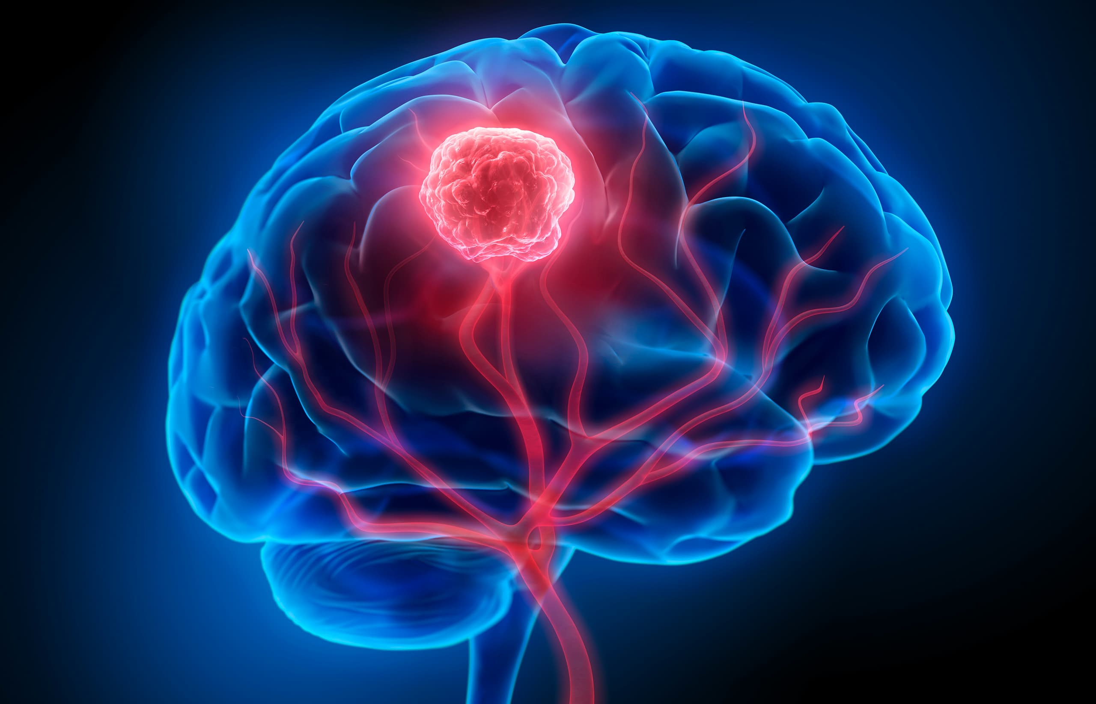
Leveraging Deep Learning
for Brain Tumor Detection and Classification
TEAM 46:
Sravya Karanam - skarana Sucharitha Nadendla - snadend3
Tanmaiyee Battula - tbattul

Slide 2
MOTIVATION
Early detection of brain tumors is crucial for effective treatment. Machine learning can play a pivotal role in improving diagnostic accuracy and speed. By automating the analysis of brain scans, we can assist radiologists in identifying tumors earlier, potentially improving patient outcomes significantly.

Slide 3
GOAL
Develop a machine learning model capable of classifying MRI images into two categories: presence or absence of a brain tumor. The task involves preprocessing image data, training a neural network, and evaluating the model's accuracy.

Slide 4
DATASET
Utilizing MRI brain scans labeled as 'Yes' (tumor) and 'No' (no tumor), we prepared a dataset designed for training deep learning models. Each image undergoes preprocessing to standardize input and enhance model performance.

Slide 5
FORMATTING THE DATASET
Images are formatted to consistent dimensions and scales. Data augmentation methods such as rotation and scaling are applied to enrich the training dataset, aiding the model in generalizing from diverse imaging conditions.

Slide 6
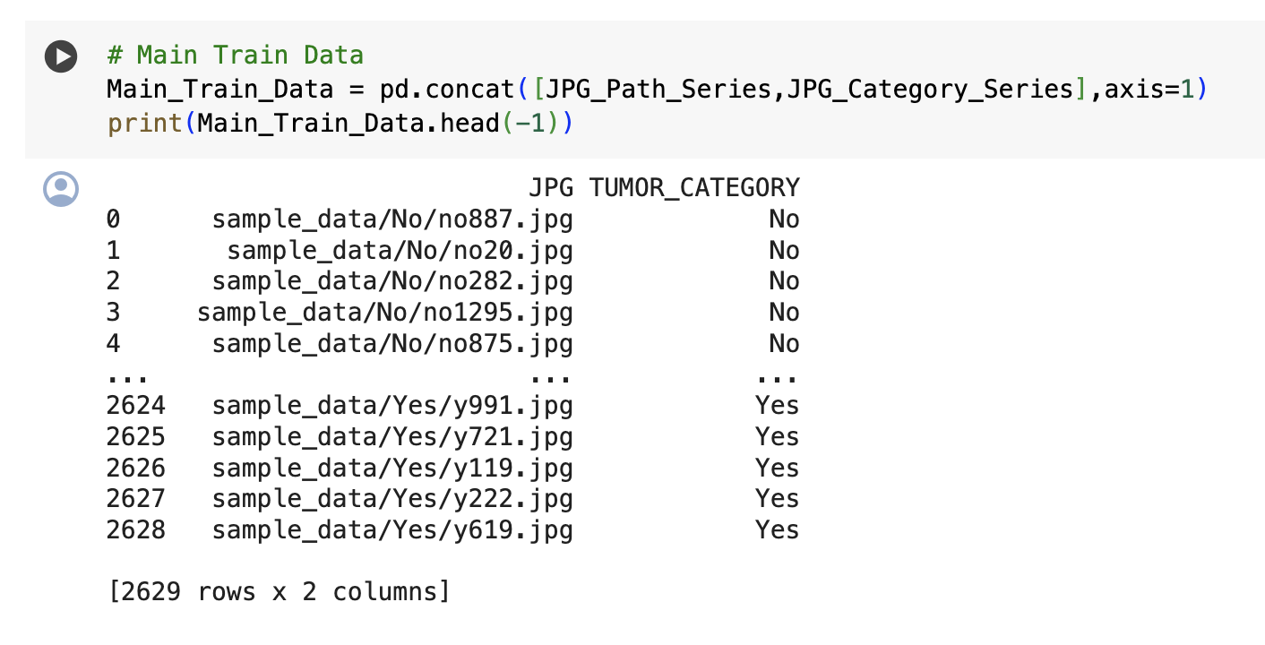
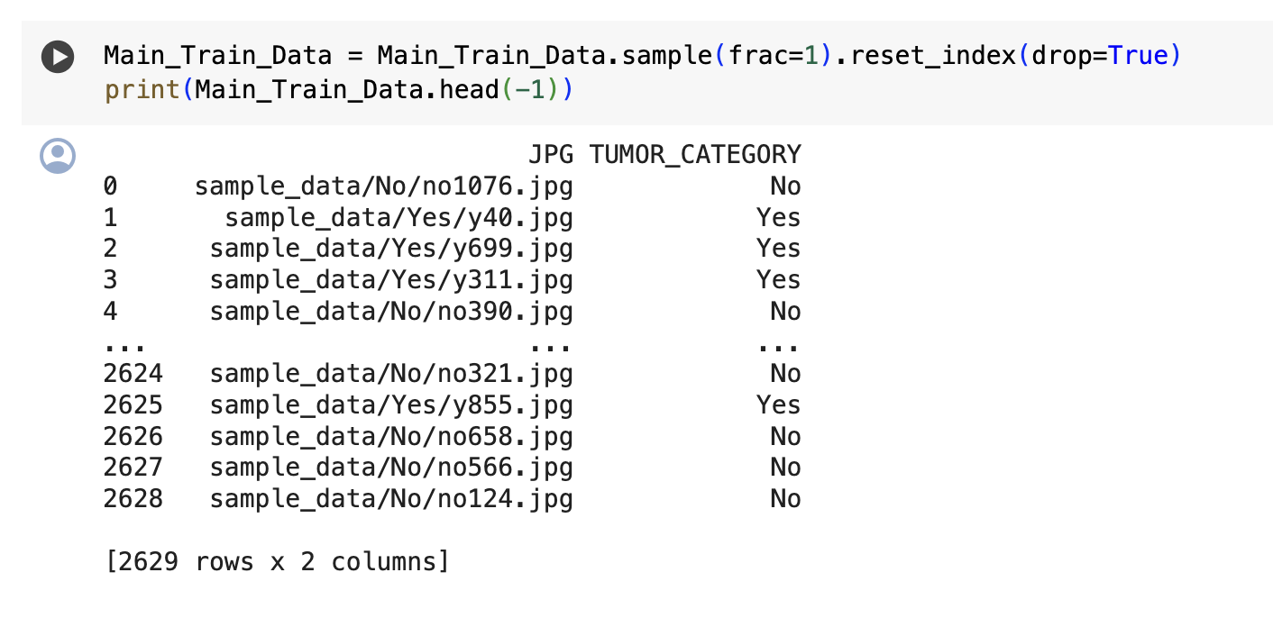
BEFORE
AFTER

Slide 7
BASELINE MODEL
The diversified CNN model showcases its capability in image classification with a notable prediction score, where it achieved a loss of 0.2580 on the test data set.
By integrating dropout techniques, the diversified model mitigates the risk of overfitting, enhancing its predictive performance on divided data.
The test results indicate the model's reliable performance in distinguishing between different classes, which is pivotal for accurate medical diagnosis and treatment planning.

Slide 8
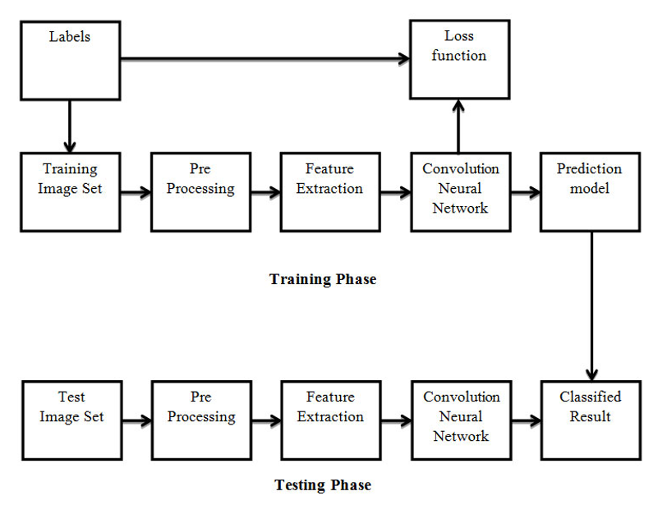

Slide 9
IMPROVISED MODEL
Our model is a convolutional neural network (CNN), structured with layers tailored to extract features from medical images efficiently. This setup serves as the foundation for detecting patterns associated with tumors.
The model uses TensorFlow’s `ImageDataGenerator` for preprocessing, which includes rescaling images by 1/255, converting them to grayscale, and managing data in batches of 20.
The CNN architecture features multiple convolutional layers with increasing complexity and dropout layers to prevent overfitting, starting with 32 filters and escalating up to 256 filters.
Includes a fully connected layer with 512 neurons post-flattening, followed by a 50% dropout and a softmax output layer for binary classification.
The model is compiled with RMSprop optimizer (learning rate 0.001), trained over 10 epochs, and uses categorical cross-entropy for loss, targeting high diagnostic accuracy.

Slide 10
RESULTS
Results include accuracy metrics and loss curves for both training and validation phases. Initial tests show promising accuracy, with potential areas for improvement identified in model tuning
Achieved a high accuracy of 99% with a low loss of 0.0775 on the test set, indicating excellent model effectiveness on unseen data.
Utilized a standalone `ImageDataGenerator` to rescale images and prepare them without labels, specifically for prediction purposes.
Predictions were made on a batch of 60 images, standardized to 200x200 pixels in grayscale.
The model classified images into categories 'NO' (no tumor) and 'TUMOR', showing a mix of both predictions, reflecting its capability to differentiate between the two categories.

Slide 11
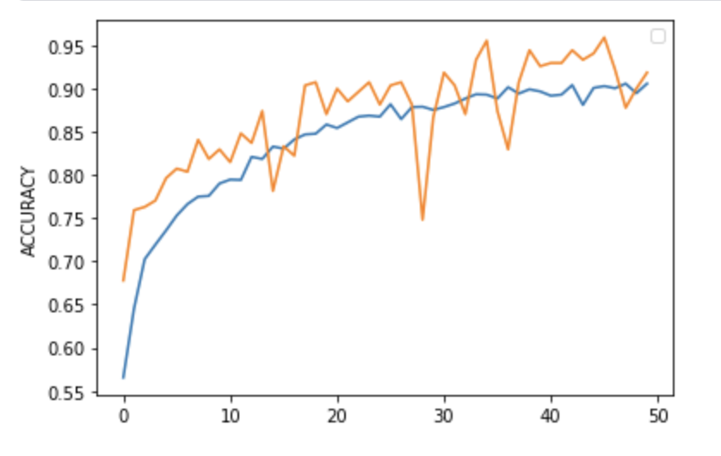
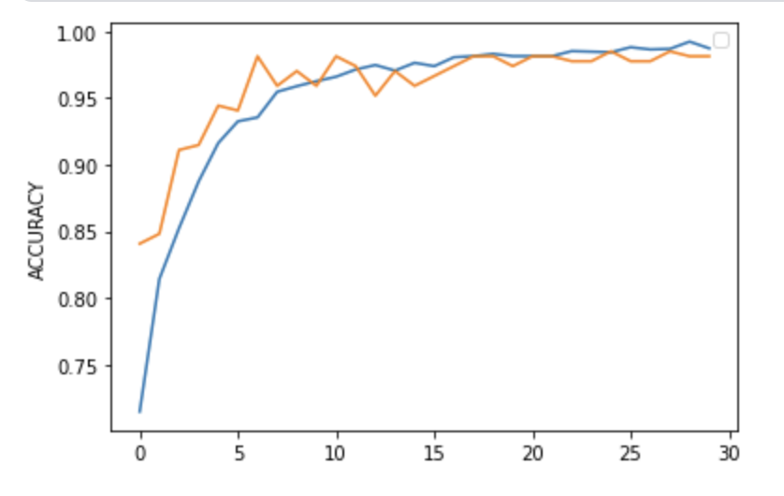
BASELINE MODEL
IMPROVISED MODEL

Slide 12
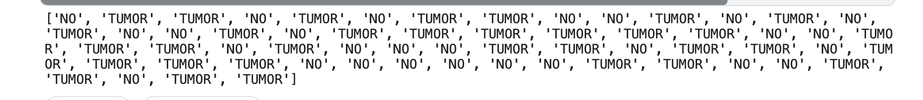
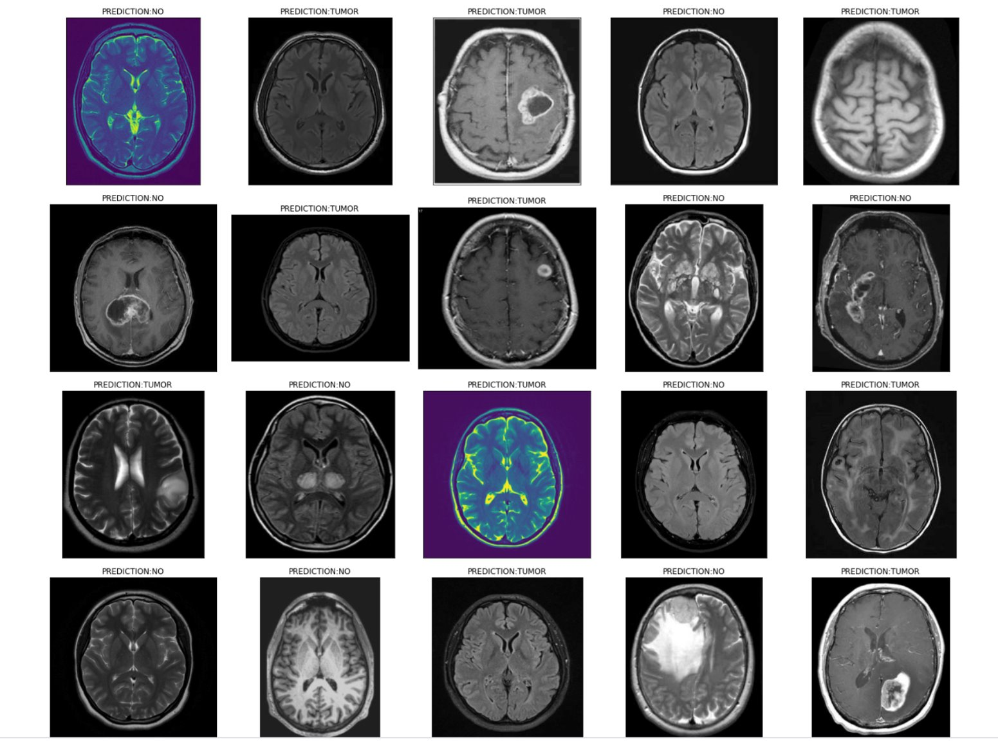

Slide 13
CONCLUSION
> Successfully demonstrated the application of convolutional neural networks (CNNs) in accurately classifying MRI brain scans into tumor and no-tumor categories.​
> Achieved promising initial results with the potential to significantly enhance diagnostic processes in medical imaging.​
> Identified areas for model improvement, particularly in enhancing generalization capabilities and reducing overfitting through advanced training techniques and data augmentation.​
> Highlighted the importance of deep learning in medical diagnostics, which could lead to faster and more accurate clinical decisions, improving patient outcomes.

Slide 14
FUTURE SCOPE
> Expand the dataset to include a more diverse range of brain MRI scans from different demographics and with various types of tumors to enhance the model’s robustness and accuracy.
> Integrate the model into a real-time diagnostic tool that can be used in clinical settings to assist radiologists in making faster and more accurate diagnoses.
> Explore the use of transfer learning and fine-tuning with pre-trained models to potentially improve performance with less data and computational resources.

